Slide 1
MIS547
Cloud Computing

Slide 2
Lecture 22: LLMs & LLMOps

Slide 3
Large language models
Next token prediction
Given a prefix of text, a language model assigns probabilities to subsequent words
“The most famous city in the US is…”
High probability
“New York”
Low probability
“Sharpie”
“Los Angeles”
“laptop”

Slide 4
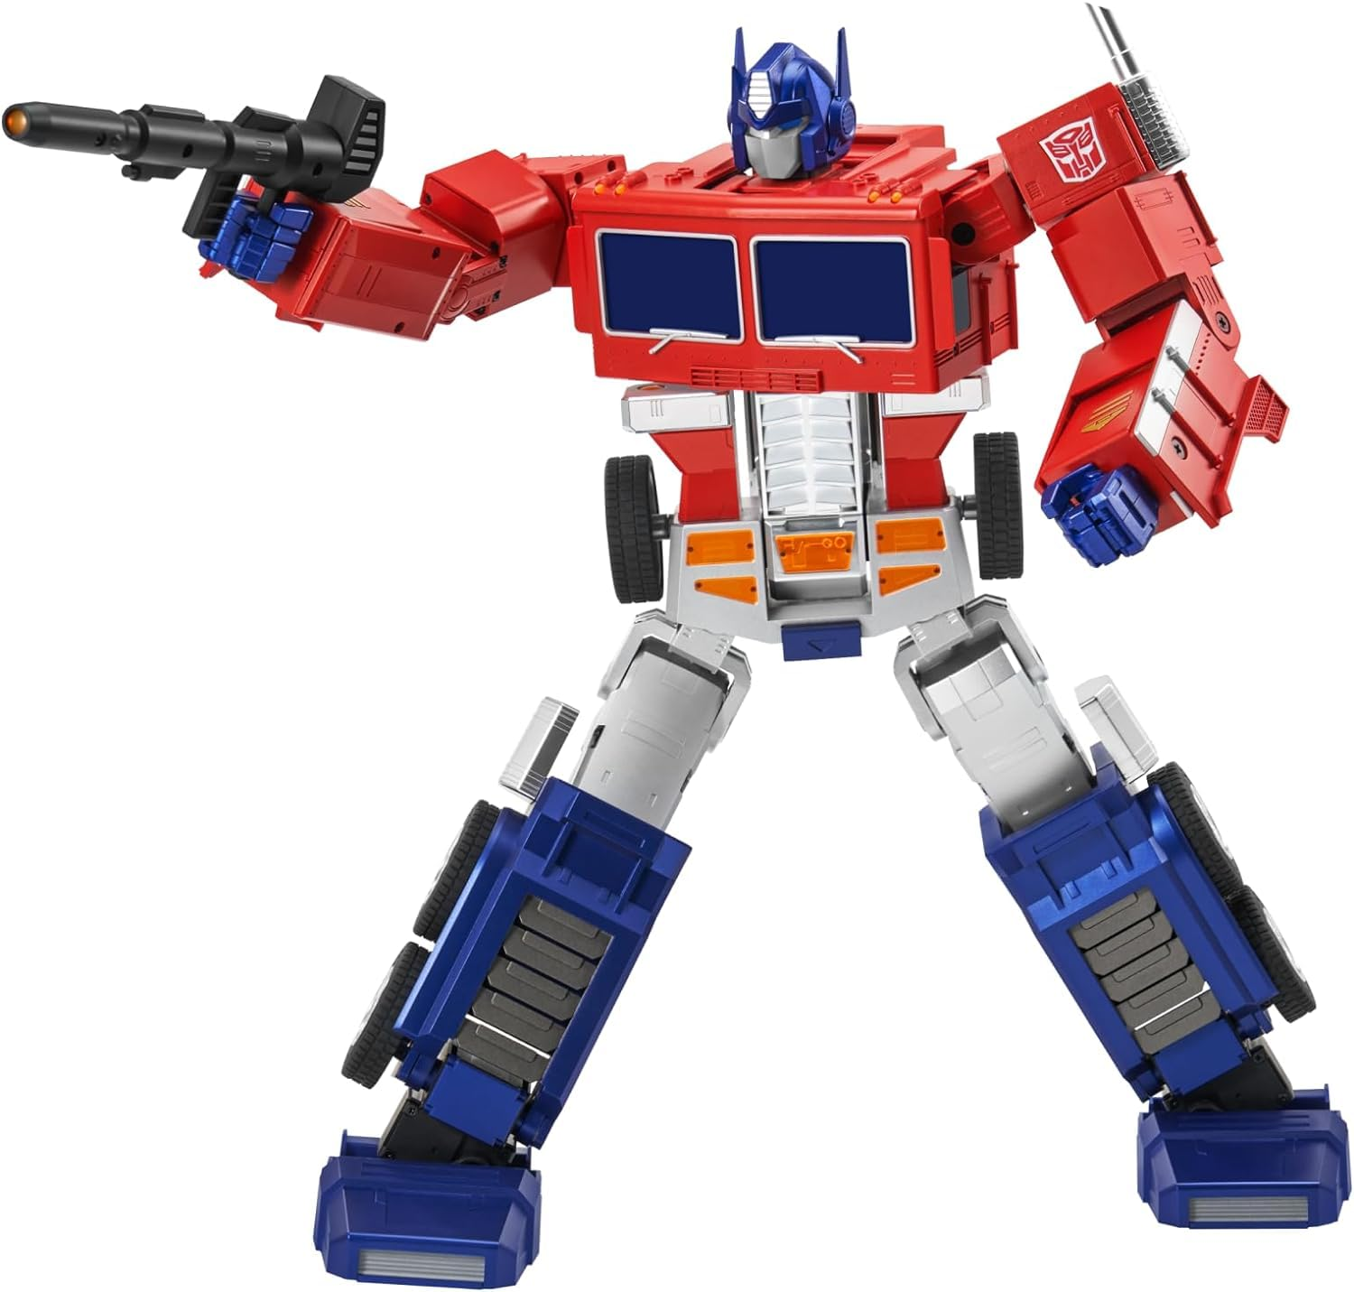
Large language models
Transformers
A type of neural network that can process sequences of tokens in parallel
Self-attention mechanism
Easier to parallelize than RNNs → faster to train, more powerful for long-term dependencies in long sequence tasks

Slide 5
Embeddings
Input
je suis etudiant
Input embedding
[0, 12, 404, 56, 0, 0, 1, …]
Output embedding
[1, 49, 50, 5, 5, 6, 0, 1,…]
Output
I am a student
Input embeddings:
Represent the input tokens to the model
Output embeddings:
Represent the output tokens that the model predicts

Slide 6
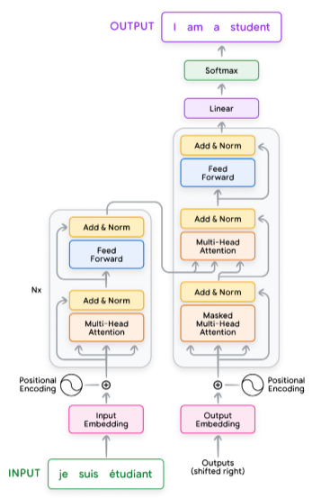
Input preparation and embedding
Convert an input sequence into tokens and then into input embeddings
An input embedding is a high-dimensional vector that represents the meaning of each token in the sentence
Steps to generate input embeddings:
Normalization
Tokenization
(words or subwords, mapped to integer token IDs from a vocabulary)
Embedding
(learned during training process)
Positional encoding

Slide 7
Self-attention
Helps to determine relationships between different words and phrases in the input text
Each input embedding is multiplied by three learned weight matrices (Wq, Wk, Wv) to generate query (Q), key (K), and value (V) vectors.
Query: The query vector helps the model ask “Which other words in the sequence are relevant to me?”
Key: The key vector is similar to a label that helps the model identify how a word might be relevant to other words in the sequence.
Value: The value vector holds the actual word content information.

Slide 8
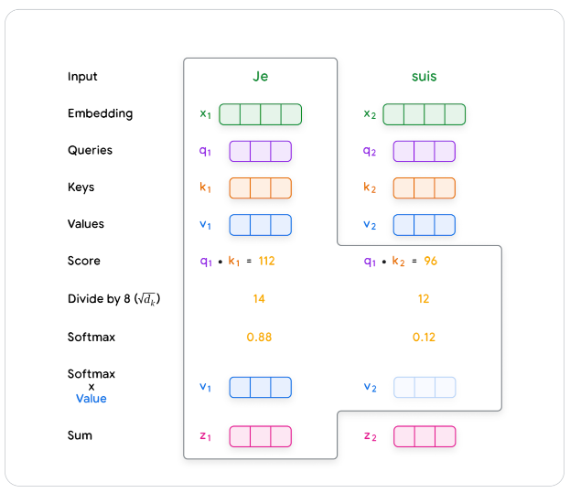
Self-Attention
Calculating Scores: Scores are calculated to determine how much each word should ‘attend’ to other words.
Take the dot product of the query vector of one word with the key vectors of all the words in the sequence
Normalization:
Scores are divided by the square root of the key vector dimension.
Then passed through a softmax function to obtain attention weights.
Weights indicate how strongly each word is connected to the others
Weighted values:
Each value vector is multiplied by its corresponding attention weight.
Results are summed, producing a context-aware representation for each word.

Slide 9
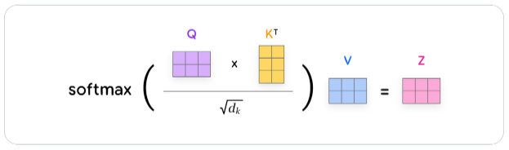
Multi-head attention
Multiple sets of Q, K, V weight matrices
Run in parallel, each ‘head’ potentially focusing on different aspects of the input relationships
Outputs from each head are concatenated and linearly transformed, giving the model a richer representation of input sequence
Improves model’s ability to handle complex language patterns and long-range dependencies

Slide 10
Encoder and decoder
The Encoder’s primary function is to process the input sequence into a continuous representation that holds contextual information for each token
Input sequence is normalized, tokenized, converted into embeddings
Positional encodings are added to retain sequence order information
Self-attention → each token in the sequence can dynamically attend to any other token, thus understanding the contextual relationships within the sequence
Output from the encoder is a series of embedding vectors Z representing the entire input sequence

Slide 11
Encoder and Decoder
The Decoder generates an output sequence based on the context provided by the encoder’s output Z.
Operates token-by-token
Beings with a start-of-sequence token
Decoder layers employ two types of attention mechanisms:
Masked self-attention: ensures each position can only attend to earlier positions in the output sequence (preserving the auto-regressive property)
Prevents decoder from having access to future tokens in the output sequence
Encoder-decoder cross-attention: allows decoder to focus on relevant parts of the input sequence, utilizing the contextual embeddings generated by the encoder
Continues until the decoder predicts an end-of-sequence token

Slide 12
Encoder and decoder
Recent LLMs adopt a decoder-only transformer architecture
Forgoes traditional encoder-decoder separation, focusing instead on directly generating the output sequence from the input
Input sequence preprocessing includes embedding and positional encoding before being fed into the decoder.
Decoder then uses masked self-attention to generate predcictions for each token based on the previously generated tokens

Slide 13
Training the transformer
Training: modifying the parameters of the model, involves loss functions & backpropagation
Inference: when the model is used only for the predicted output, without updating the model weights
Model parameters are fixed during inference

Slide 14
Training the transformer
Batches of input sequences are sampled from a training dataset
For each input, there is a corresponding target sequence
In unsupervised pre-training, the target sequence is derived from the input sequence itself
The batch of input sequences is fed into the transformer
The transformer predicts output sequences
The difference between predicted and target sequences is measure using a loss function (usually cross-entropy loss)
Gradients of the loss are calculated, and an optimizer uses them to update the transformers’ parameters
This is repeated until the transformer converges to a certain level of performance or until it has been pretrained on a pre-specified number of tokens

Slide 15
Training the transformer
Decoder-only
Pre-trained on language modeling task
Target sequence for decoder is simply a shifted version of the input sequence
“the cat sat on” → “the”
“the cat sat on the” → “mat”
Encoder-only
E.g., BERT
Pre-trained by corrupting the input sequence and having the model try to reconstruct it.
Masked language model (MLM):
“The [MASK] sat on the mat” → “The cat sat on the mat”
Encoder-decoder
Trained on sequence-to-sequence supervised tasks
Translation
”Le chat est assis sur le tapis” →
Question answering:
Summarization
“The cat sat on the mat”

Slide 16
Context length
The number of previous tokens the model can ‘remember’ and use to predict the next token in the sequence
Longer context lengths allow the model to capture more complex relationships and dependencies within the text, potentially leading to better performance
Longer contexts also require more computational resources and memory
Balance between performance and training

Slide 17
Transformer evolution
GPT-1
Generative pre-trained transformer version 1
Decoder-only model developed by OpenAI
BooksCorpus dataset (several billion words)
Main innovations
Combines transformers and unsupervised pre-training
Semi-supervised sequence learning
Usupervised pre-training followed by supervised training

Slide 18
Transformer evolution: GPT-1
Task- aware input transformations
Question answering requires a context document (a question) and possible answers
GPT-1 converts these types of tasks which require structured inputs into an input that the language model can parse without requiring task-specific architectures on top of the pre-trained architecture
Context document c is concatenated with the question q and a possible answer a, with a delimeter token in between the question and answer –[c, q, $, a]

Slide 19
Transformer evolution: BERT
Bidirectional encoder representations from transformers
Encoder-only architecture
Focuses on understanding context deeply by training on a masked language model objective
Random words in a sentence are replaced with a [MASK] token and BERT tries to predict the original word based on the surrounding context
Next sentence prediction loss
Learns to determine whether a given sentence logically follows a preceding one
BERT captures intricate context dependencies between pairs of sentences
BERT is especially good at tasks that require natural language understanding
Question-answering
Sentinemtn analysis
Natural language inference
BERT cannot generate text

Slide 20
Transformer evolution: GPT-2
2019
Direct scale-up (tenfold increase in both parameter count and the size of its training dataset)
Trained on 40GB WebText dataset
45M webpages from Reddit w/ karma >=3
1.5B parameters
Performed well in some tasks, did not outperform SOTA reading comprehension, summarization, translation
Most significant achievement was zero-shot learning on a variety of tasks
Zero-shot task transfer:
Ability of a model to generalize to a new task without being trained on it
Input: [<An English sentence>, “German”, “:”]
Model ‘understands’ that this is a translation task and generate the German translation of the English sentence

Slide 21
Transformer evolution: GPT-3/3.5
Most notable difference is the size of GPT-3
175B parameters (compared to GPT-2 w/ 1.5B)
Store and recall vast amount of information, generate more coherent and contextualy relevant text over longer passages
Better generalization across range of tasks
Instruction tuning
InstructGPT
Reinforcement Learning from Human Feedback
1.3B parameter InstructGPT model had better human evaluations than 175B GPT-3 model

Slide 22
Transformer Evolution: GPT-4
Extends GPT-3.5 as a large multimodal model capable of processing image and text inputs & produces text outputs
Receive context windows of up to 128,000 tokens, has a maximum output of 4,096 tokens
Complex tasks: mathematics, coding, vision, medicine, law, psychology

Slide 23
Transformer Evolution: LaMDA
Language Model for Dialogue Applications
Designed to engage in open-ended conversations
Trained on dialogue-focused data
Primary focus is maintaining and enhancing conversational depth and breadth

Slide 24
Transformer Evolution: Gopher
280B parameter based on decoder-only architecture
DeepMind 2021
Generate text, translate languages, write different kinds of creative content, answer questions
MassiveText dataset: 10TB data, 2.45B documents from web pages, books, news articles, code (GitHub)
Improved quality of dataset by filtering it, removed duplicate text and deduplicating similar documents

Slide 25
Transformer Evolution: Chinchilla
DeepMind 70B parameter model
Compute-optimal scaling laws
Near equal scaling in parameters and data is optimal with increasing compute
100 fold increase in compute should translate into a 10-fold increase in both data size and model size
4x smaller than Gopher, outperforms Gopher, GPT-3, Megatrong-Turing NLG
Finding ways to scale dataset size (while maintaining quality) alongside increasing parameter count

Slide 26
Transformer Evolution: Gemini
Multimodal language family of models
Transformer decoders
Mixture-of-experts model

Slide 27
Open Models
LLaMA 2
Meta
Family of pretrained and fine-tuned LLMs ranging from 7B-70B parameters
LLaMA 2-Chat optimized for dialogue
LLaMA 3.2
Meta AI
Multilingual text-only models (1B, 3B) and vision LLMs (11B, 90B)
Mixtral
Mistral AI
Sparse Mixture of Experts model
Excels in mathematics, code generation, multilingual tasks
32K token context length

Slide 28
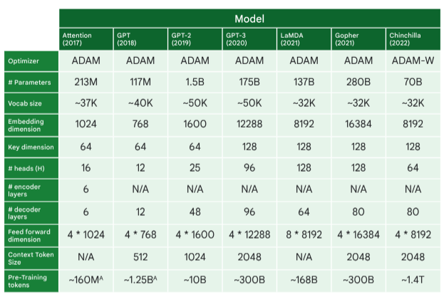
Transformer model comparison
source: Google

Slide 29
Fine Tuning Language models

Slide 30
Fine Tuning Language Models
Pre-training
The foundational stage where an LLM is trained on a large, diverse, unlabelled dataset
Tasked to predict the next token given the previous context
Leverage a large, general distribution of data, create a model that is good at sampling from this general distribution
Most expensive in terms of time and amount of compute

Slide 31
Fine Tuning Language models
After training, model can be specialized via fine-tuning
Instruction-tuning or supervised fine tuning (SFT)
SFT trains an LLM on a set of task-specific demonstration datasets where performance is evaluated across domain-specific tasks
Instruction-tuning/ instruction-following
LLM is provided as input an instruction to follow which might include summarizing text, writing code, writing a poem
Dialogue-tuning
LLM is fine-tuned on conversational data in the form of questions and responses (multi-turn dialogue)
Safety tuning
mitigates risks from bias, discrimination, toxic outputs
Reinforcement learning with human feedback

Slide 32
Fine Tuning Language models
Supervised fine-tuning
Each datapoint consists of an input (prompt) and a demonstration (target response)
Question (prompt) | Answer (target)
English (prompt) | Spanish (target)
Document (prompt) | summary (target)

Slide 33
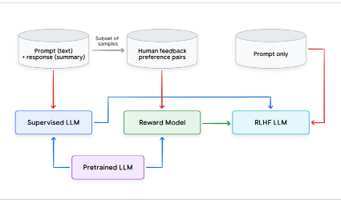
Fine Tuning Language models
Reinforcement learning from human feedback
RLHF
Reward model
Initialized with a pretrained transformer model
Tuned on human preference data
RLAIF leverages AI feedback instead of human feedback

Slide 34
Fine Tuning Language models
Parameter efficient fine tuning (PEFT)
Append a smaller set of weights that are used to perturb the pre-trained LLM weights
Adapter-based fine-tuning: small modules (adapters) are used to perturb the weights
Only the adapter parameters are trained
Low-Rank Adaptation (LoRA): tackles efficiency directly using two smaller matrices to approximate the original weight matrix update instead of fine-tuning the whole LLM
Freezes the original weights and trains these update matrices
QLoRA: quantized weights for greater efficiency
Plug-and-play: train a LoRA module that specializes in one task and easily replace it with another LoRA module trained on a different task

Slide 35
Prompt engineering
Providing clear instructions to the LLM
Giving examples
Using keywords
Format to emphasize important information
Provide additional background

Slide 36
Prompt engineering
Few-shot prompting
Provide the LLM a task description as well as a few (three to five) carefully chosen examples
Example: provide the name of a few countries and their capital cities, then ask it to generate the capital for a new country that isn’t in the examples
Zero-shot prompting
Provide the LLM directly with a prompt with instructions
Chain-of-thought prompting
Aims to improve performance on complex reasoning tasks; provide a prompt that demonstrates how to solve similar problems using step-by-step reasoning
LLM then generates its own chain of thought for the new problem, breaking it down into smaller steps and explaining its reasoning

Slide 37
Sampling techniques
Essential for controlling quality, creativity, and diversity of LLM’s output
Greedy search:
Selects the token with highest probability at each step
Simplest option, can be repetitive and predictable
Random sampling:
Selects next token according to probability distribution, where each token is sampled proportionally to its predicted probability
More surprising and creative text, higher chance of non-sensical output
Temperature sampling
Adjusts probability distribution by a temperature parameter
Higher temperature promotes diversity, lower temperature favor high-probability tokens

Slide 38
Sampling techniques
Top-K sampling:
Rnadomly selects from the top K most probable tokens
Value of K controls the degree of randomness
Top-P sampling:
Nucleus sampling
Samples from a dynamic subset of tokens whose cumulative probability adds up to P
Allows model to adapt the number of potential candidates depending on its confidence, favoring more diversity when uncertain and focusing on a smaller set of highly probable words when confident
Best-of-N sampling:
Generates N separate repsonses and selects the one deemed best according to a predetermined metric
Useful for short snippets or situations where logic and reasoning are key

Slide 39
Sampling Techniques
Combining prompt engineering with sampling techniques and correctly calibrated hyperparameters can greatly influence the LLM’s response, making it more relevant, creative, and consistent for your needs.

Slide 40
Accelerating inference
Developers are incentivized to reduce cost and latency for model users
Balancing the expense of serving a model in terms of time, money, and energy == cost-performance tradeoff
Main compute resources used by LLMs: memory and computation
Improving inference focuses primarily on these resources
Finding ways to optimize inference performance has become a priority and an active research topic with significant advancements

Slide 41
Accelerating inference
Quality vs Latency/ Cost Tradeoff
Improve speed and cost of inference through accepting marginal drops in model’s accuracy
Latency vs Cost Tradeoff
Latency vs Throughput tradeoff where throughput refers to the system’s ability to handle multiple requests efficiently
Better throughput on the same hardware means that the LLM inference cost is reduced
Bulk inference: cost is more of a factor than latency of a request
LLM chatbot: much higher importance on request latency

Slide 42
Accelerating inference
Output-approximating methods
Quantization
Distillation
Output-preserving methods
Flash attention
Prefix caching
Speculative decoding
Batching and parallelization

Slide 43
Vector search algorithms

Slide 44
Vector Search Algorithms
Approximate Nearest Neighbor (ANN)
Finds closest points to a given point in a dataset with small margin of error
Locality sensitive hashing & trees
LSH: finding similar items in a large dataset
Create one or more hash functions that map similar items to the same hash bucket with high probability
Quickly find all of the similar items to a given item by only looking at the candidate items in the same hash bucket (or adjacent buckets) and do a linear search among those candidate pairs
Kd-trees: creates the decision boundaries by computing the median of the values fo the first dimension, then second dimension, etc.
Ball-tree algorithm: creates buckets based on the radical distance of the data points from the center

Slide 45
Vector Search Algorithms
Facebook AI similarity search (FAISS)
Hierarchical navigable small world to perform vector similarity search in sub-linear (O(Logn)) runtime
HNSW is a proximity graph with a hierarchical structure where the graph links are spread across different layers
Scalable approximate nearest neighbor (ScaNN)
Partitioning step: partitions vector store into logical partitions/clusters where semantically related items are grouped together
User-specified distance measure to select the specified number of top-partitions
Scoring step: compares the query with all the points in the top partitions and selects the top K

Slide 46
Vector Databases

Slide 47
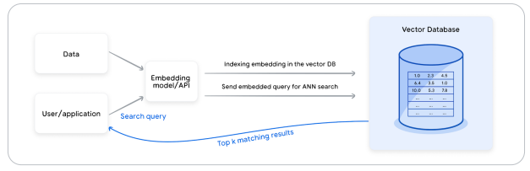
Vector databases
Built to manage vectors and vector search algorithms
Embedding model is used to embed the relevant data points as vectors with fixed dimensions
Vectors are augmented with metadata and complementary information (tags, etc.), indexed using specified algorithm for efficient search
Incoming query is embedded with the same model, and used to query and return specific amounts of the most semantically similar item and their associated unembedded content/metadata
Some databases provide caching and pre-filtering and post-filtering capabilities to further enhance the query speed and performance

Slide 48
Vector Databases
Vertex AI Vector Search
AlloyDB & Cloud SQL Postgres
Pinecone
Weaviate
ChromaDB

Slide 49
Vector Databases- Concerns
Horizontal and vertical scalability
Availability
Data consistency
Real-time updates
Backups
Access control
Compliance
…

Slide 50
Vector databases- Concerns
Embeddings can mutate over time, especially after retraining (to account for drift, changing objectives, etc.)
Frequently updating embeddings can be prohibitively expensive
Sometimes need combination of full-text search to pre-filter or post-filter search space before passing it onto the semantic search module

Slide 51
Language Model Tasks + Approaches

Slide 52
Tasks
Task | Description
Retrieval | Given a query and a set of objects, retrieve the most relevant objects. Depending on the definition of relevant objects, subtasks include question answering and recommendations
Semantic text similarity | Determine whether two sentences have the same semantic meaning. Subtasks include: paraphrasing, duplicate detection, bitext mining
Classification | Classify objects into possible categories. Based on the number of labels, subtasks include binary classification, multi-class classification, multi-label classification
Clustering | Cluster objects together
Reranking | Rerank a set of objects based on a certain query

Slide 53
Q&A with Retrieval Augmented Generation
RAG: a technique that combines retrieval and generation
First retrieves relevant documents from a knowledge base and then uses prompt expansion to generate an answer from those documents
Prompt expansion: model retrieves relevant information from the database (mostly using a combination of semantic search and business rules) and augments the original prompt with it

Slide 54
RAG
RAG can reduce hallucinations, but it does not eliminate them
Return sources from the retrieval and do a quick coherence check either by a human or an LLM

Slide 55
Agents

Slide 56
Agents
An agent is an application that attempts to achieve a goal by observing the world and acting upon it using the tools that it has at its disposal.
Agents are autonomous
Agents can be proactive in their approach to reaching their goals
An agent has a cognitive architecture comprise of behaviors, actions, and decisions

Slide 57
The model
In the context of an agent, a model refers to the language model that will be used as the centralized decision maker for agent processes
The model can be one or multiple LMs capable of following instruction-based reasoning and logic frameworks
ReAct, Chain-of-thought, Tree-of-Thoughts
Models can be general purpose, multi-modal, or fine-tuned

Slide 58
The tools
Foundation models can’t interact with the outside world on their own
Tools allow agents to interact with external data and services
Tools typically align with common web API methods:
GET, POST, PATCH, DELETE

Slide 59
Tools
Tools can:
Update customer information in a database
Fetch weather data to influence a travel recommendation
Agents can access and process real-world information using tools
Tools empower more specialized systems like retrieval augmented generation

Slide 60
Orchestration
How the agent takes in information, performs internal reasoning, uses that reasoning to inform next action or decision
Loop continues until an agent has reached its goal or a stopping point
Decision rules, chained logic, additional ML algorithms, other probabilistic reasoning techniques

Slide 61
Agents vs Models
Models | Agents
Knowledge limited to what is available in their training data | Knowledge is extended through the connection with external systems via tools
Single inference/ prediction based on the user query; no management of session history or continuous context | Managed session history allows for multi-turn inference/ prediction based on user queries and decisions made in the orchestration layer. A turn is defined as an interaction between the interacting system and the agent
No native tool implementation | Tools are natively implemented in agent architecture
No native logic layer implemented. Users form prompts as simple questions or use reasoning frameworks | Native cognitive architecture that uses reasoning frameworks like CoT, ReAct, or LangChain

Slide 62
Cognitive architectures
Orchestration layer is responsible for maintaining memory, state, reasoning, planning
ReAct
Prompt engineering framework that provides a thought process strategy for language models to reason and take action on a user query, with or without in-context examples
Chain-of-Thought (CoT)
Prompt engineering framework that enables reasoning capabilities through intermediate steps
Sub-techniques:
Self-consistency, active-prompt, multimodal CoT that each have strengths and weaknesses depending on the application
Tree-of-thought
Prompt engineering framework that is well suited for exploration or strategic lookahead tasks
Generalizes over chain-of-thought prompting and allows model to explore various thought chains that serve as intermediate steps for general problem solving with language models

